Slide 1

ECE382
Lesson 2
1

Slide 2
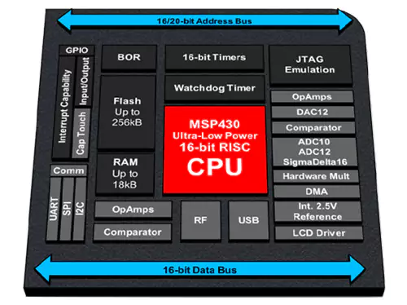
Outline
Lesson Outline
uC Comparison
Intro to the MSP430
MSP430 Architecture
Why?
Most likely you will use an embedded system or uC in another class or capstone … you need to know “when to use what”
These are all tools in a toolbox, pick the right one
There NEVER is one right answer!
All of these have similar (same?) capabilities, so learning it on an MSP430 will help you on another uC

Slide 3
Micro-Controllers (uC) and Embedded Systems
There are many popular systems out there, with AVR (think Arduino) being very popular
Both the MSP430 and Atmega328, you can easily build a system using just the chip and a couple parts
All systems below support I2C, SPI, and UART serial comm
Only the Raspberry Pi has Ethernet, Bluetooth and Wifi 2.4/5 GHz
But it also requires an OS, the uC’s don’t
Arduino | Raspberry Pi | TI Launchpad
Atemga328 | ARMv8 quad core | MSP430G2553
2 KB RAM 32 KB Flash | 1 GB RAM | 512 B RAM 16 KB Flash
23 GPIO 6 ADC, 10b | 40 I/O pins | 20 GPIO pins 8 ADC, 10b
Chip: $1.64 | Board: $35 | Chip: $1.68

Slide 4
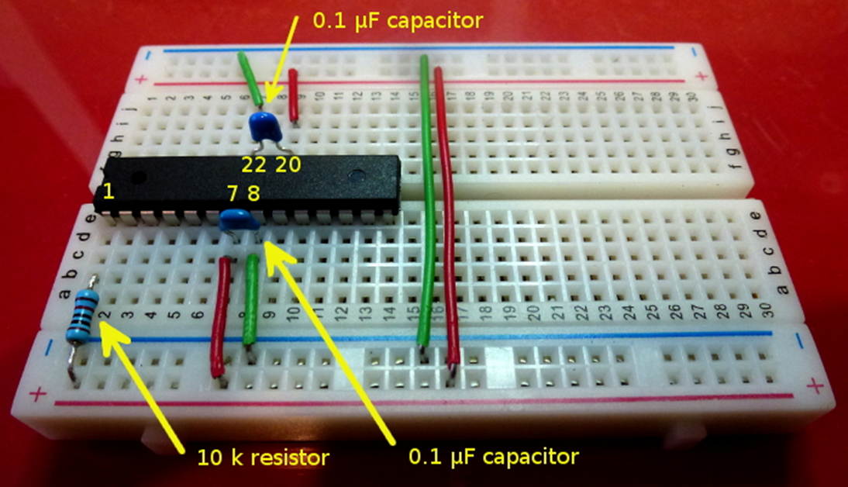
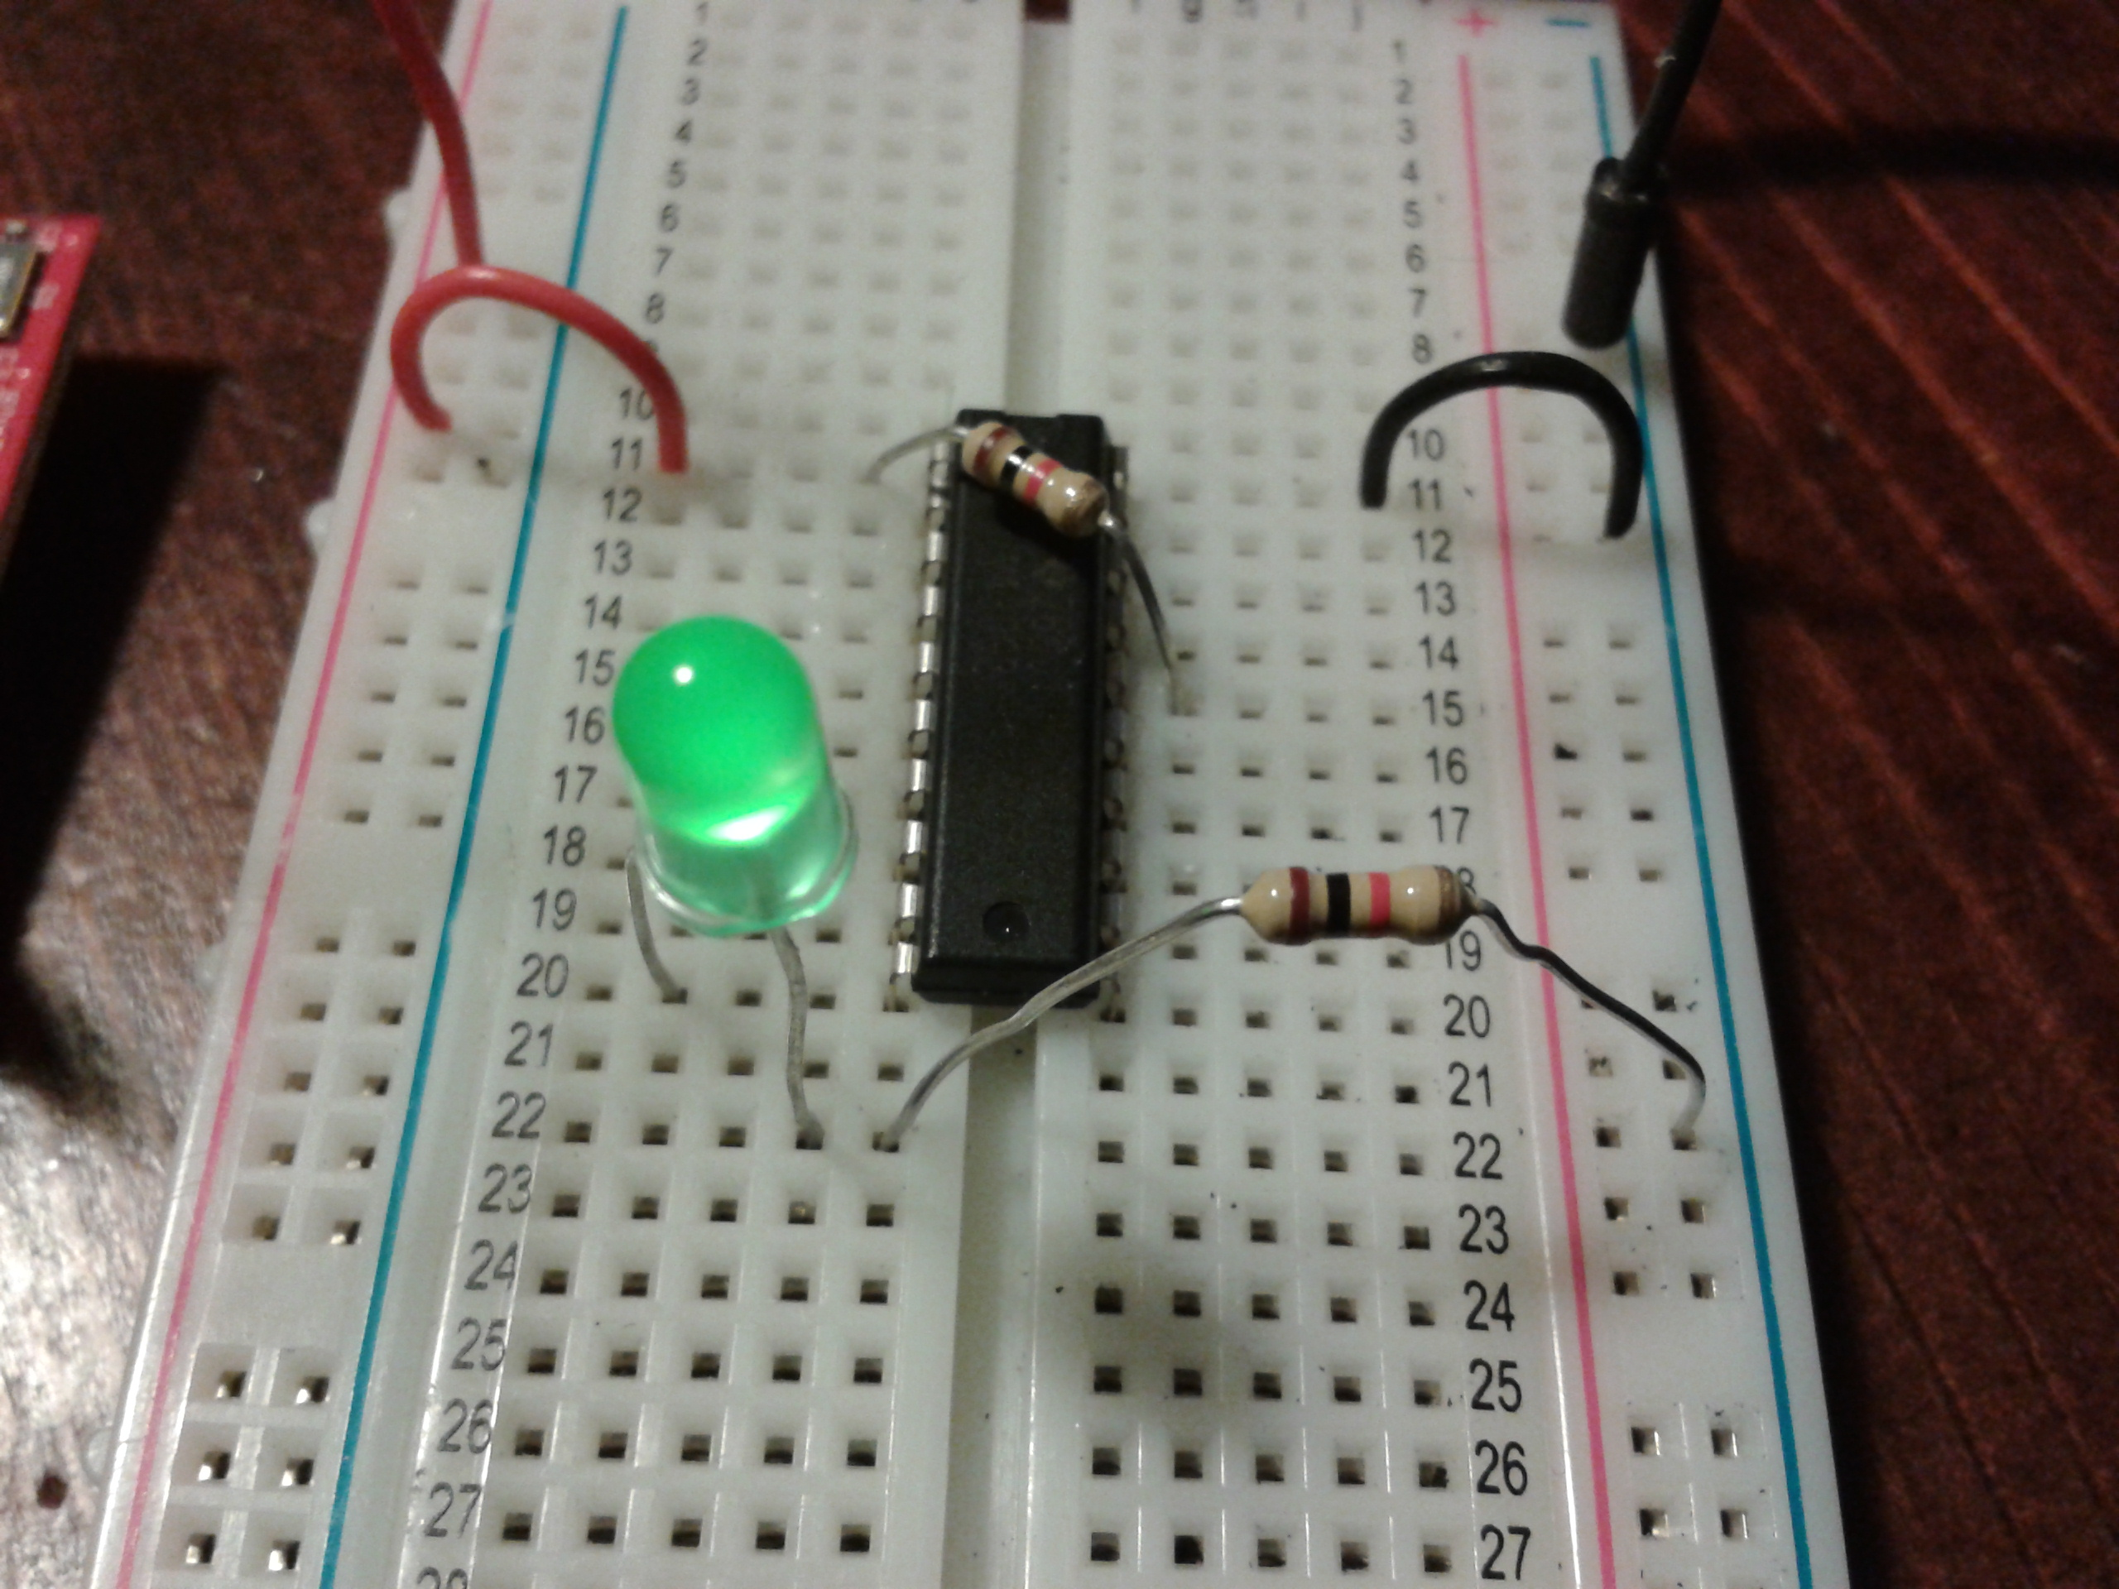
Learn on Simple Systems
Minimum HW to get the Atmega328 (Arduino) running
Minimum HW to get the MSP430 running
Although the Raspberry Pi is cool, it is insanely complicated compared to a uC plus it add the complexity of an OS

Slide 5
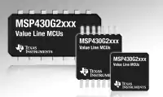
Intro to the MSP430
The MSP430 is a low-cost, low-power consumption embedded applications
RISC architecture with just 27 instructions.
Our version: Msp430g2553
Why use it?
Very simple architecture
Low cost, low power
Excellent IDE … something Arduino doesn’t have
Realistically, you will use either the Pi or an Arduino in other courses/capstone

Slide 6
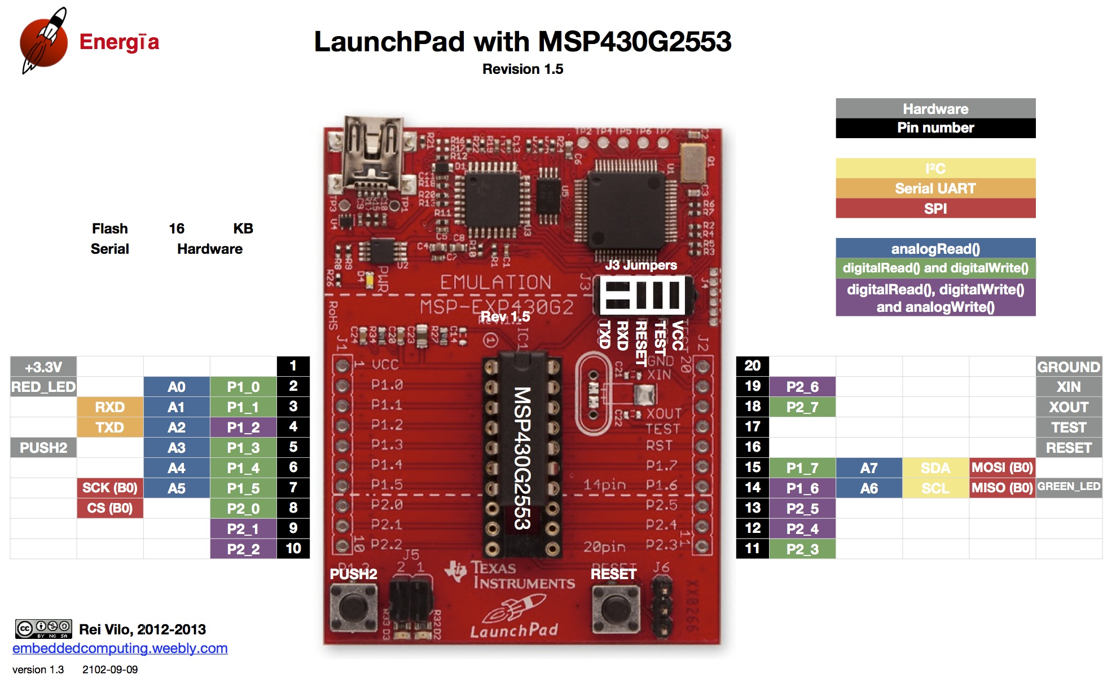
TI Launchpad

Slide 7
Instruction Set Architecture (ISA)
ISA consists of
set of operations (instructions)
registers
data units (byte/word/etc)
addressing modes
memory organization / memory map

Slide 8
MSP430’s ISA
RISC architecture
fewer instructions (27)
emulates higher-level instructions (about 27)
for instance, NOP → ___________
16-bit datapath
Mov r3, r3

Slide 9
MSP430’s ISA
16-bit datapath
word size is 16 bits
word is the natural unit of info for the processor
16 bit addresses
16 bit registers
all instructions are 16 bits long
this consistency isn't necessarily true of all processors, but it's convenient - allows us to load addresses into registers, perform ops on them, etc.
What is a register?

Slide 10
MSP430’s ISA
Registers - 16 bits wide
Fast memory that holds values in-use by the CPU
Four special purpose registers
r0 - Program Counter - holds address of instruction currently being executed
r1 - Stack Pointer - address of top of stack
r2 - Status Register - holds flags related to various conditions
r3 - Constant Generator - 0, but can assume other values for different addressing modes
12 general purpose registers
r4 to r15: can be used to hold anything you want

Slide 11
MSP430’s ISA
Set of Operations
27 Instructions in 3 families
Single-operand
for instance, SWPB r12
Conditional jump
for instance, JMP jump_label
Two-operand
for instance, MOV r12, r10
Extension words
Additionally, depending on how you use these instructions, you might add more words to your commands
You will see this when we turn assembly into machine code

Slide 12
MSP430’s ISA
Data Units
byte-addressable memory
instructions for byte and word actions
MOV.B r12, r10
MOV.W r12, r10 (if not specified, default: word)
MOV r12, r10 (this is a word operation)
remember, word size is 16 bits
words must lie on even addresses
The HW prevents you from access bytes … we’ll see that later

Slide 13
MSP430’s ISA
How many addr bits?
Msp430g2553 Memory Map
512b of RAM - 0x200-0x400 16kb of ROM - 0xc000-0xffdf
0x1100-0xbfff is empty!
There is no memory backing it up!
If you attempt to write to this area of memory, you'll trigger what's essentially a segmentation fault because that memory doesn't exist. It will cause the chip to do a Power-up Clear (PUC), resetting the state of your processor. This is a tough error to debug.

Slide 14
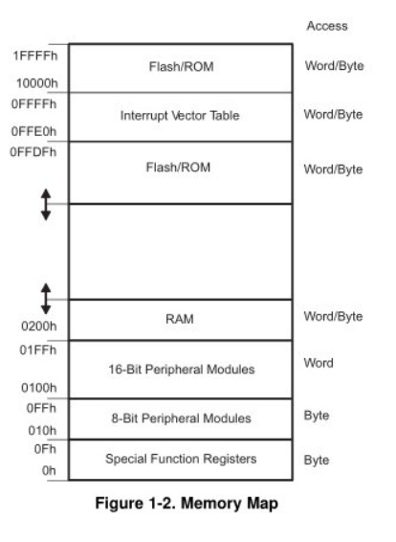
MSP430’s ISA
How many addr bits?
 |  | MSP430G2553
Memory Main: interrupt vector Main: code memory | Size Flash Flash | 16kB 0xFFFF to 0xFFC0 0xFFFF to 0xC000
Information memory | Size Flash | 256 Byte 010FFh to 01000h
RAM | Size | 512 Byte 0x03FF to 0x0200
Peripherals | 16-bit 8-bit 8-bit SFR | 01FFh to 0100h 0FFh to 010h 0Fh to 00h
Excerpt from Table 8: Memory Organization from MSP430G2x53 Device Specific User Guide (pp13)

Slide 15
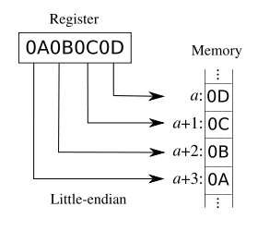
MSP430Architecture Uses Little Endian
Values stored in little-endian byte order
Least significant byte is stored first
Note, the address provides location to a BYTE and NOT a BIT
MSB
LSB
Memory Address
5000
LSB
Notice the difference between how humans write things on paper, but the machine stores it in memory!
5001
5002
5003
MSB

Slide 16
Assembly and Machine Languages
Instructions:
words in a computers language
Instruction Set:
the dictionary of the language
Assembly Language:
human-readable format of computer instructions
Machine Language:
computer-readable instructions - binary (1's and 0's)

Slide 17
Assembly and Machine Languages
Instructions:
words in a computers language
Instruction Set:
the dictionary of the language
Assembly Language:
human-readable format of computer instructions
Machine Language:
computer-readable instructions
binary (1's and 0's)
Your Assembly Program
Assembler
This is what the IDE does, for us it is Code Composer Studio (CCS)
Relocatable Object Code
Linker
Now, on a computer with an OS, this would be a potential App the user could run … on a uC, there is no choice and this is the only code that runs
Executable Code

Slide 18
Example MSP430 program
; This program sets all pins on Port 1 to output and high.
; Since LEDs 1 and 2 are connected to P1.0 and P1.6
; respectively, they will light up.
.include 'header.S'
.text
main:
mov.w #WDTPW, r15 ; turn off watchdog timer
xor.w #WDTHOLD, r15
mov.w r15, &WDTCTL
bis.b #0xFF, &P1DIR ; set port1 direction to output
bis.b #0xFF, &P1OUT ; turn on leds at port1
loop:
jmp loop ; loop forever
Instructions similar to the ones you used in ECE281

Slide 19
Disassembled Code
The point here, is, the linker changes the addresses of the relocatable code for your SPECIFIC uC (G2553). A different model could have different addresses
Disassembly of section .text:
0000c000 <__ctors_end>:
c000: 3f 40 00 5a mov #23040, r15 ;#0x5a00
c004: 3f e0 80 00 xor #128, r15 ;#0x0080
c008: 82 4f 20 01 mov r15, &0x0120
c00c: f2 d3 22 00 bis.b #-1, &0x0022 ;r3 As==11
c010: f2 d3 21 00 bis.b #-1, &0x0021 ;r3 As==11
0000c014 <loop>:
c014: ff 3f jmp $+0 ;abs 0xc014

Slide 20
Backups

